Slide 1

ADVANCED COMPUTER PROGRAMMING
INTRODUCTION TO JAVA
Week 1 — Course Foundation & Environment Setup

Slide 2
ADVANCED COMPUTER PROGRAMMING
COURSE OVERVIEW
01
Introduction to IDE
02
Introduction to Java
03
History & Features
Understanding the Integrated Development Environment
Java language and its core components
Evolution and characteristics of Java
04
Compilation Process
05
Java Applications
06
JDK & Editions
From source code to execution
Types and real-world examples
Development Kit and platform editions
07
Development Tools
Build tools and the Java ecosystem
02

Slide 3

01
INTRODUCTION TO IDE
Understanding the Integrated Development Environment

Slide 4

ADVANCED COMPUTER PROGRAMMING
What is an IDE?
An Integrated Development Environment (IDE) is a software application that provides comprehensive facilities to programmers for software development.
Key Capabilities
Code Editor
Syntax highlighting & completion
Version Control
Git & SVN integration
Debugger
Step-by-step error detection
Refactoring
Code restructuring tools
Build Automation
Compile, test, and deploy
Project Management
Organize files & dependencies
Modern IDEs significantly boost developer productivity by integrating all essential tools into a single, unified interface.
04

Slide 5
ADVANCED COMPUTER PROGRAMMING
Key Components of an IDE
1
Source Code Editor
2
Compiler / Interpreter
3
Debugger
Provides syntax highlighting, code completion, error detection, and intelligent suggestions as you type.
Translates human-readable code into machine-executable instructions and reports compilation errors.
Helps identify and fix errors by allowing step-by-step execution, breakpoints, and variable inspection.
4
Build Automation Tools
5
Version Control
6
Project Management
Automates repetitive tasks like compilation, testing, and packaging of applications.
Integrates Git and SVN to manage code changes, branches, and collaboration directly within the IDE.
Organizes files, dependencies, libraries, and resources in a structured project hierarchy.
An IDE integrates all these components into a single environment, dramatically improving developer productivity and code quality.
05

Slide 6
ADVANCED COMPUTER PROGRAMMING
Popular Java IDEs Comparison
Feature | IntelliJ IDEA | Eclipse | NetBeans | VS Code
Price | Free (Community) / Paid (Ultimate) | Free & Open Source | Free & Open Source | Free & Open Source
Strengths | Advanced code analysis, smart refactoring, modern UI | Highly customizable, vast plugin ecosystem | User-friendly, great for beginners, JavaFX support | Lightweight, highly extensible, fast
Best For | Professional & enterprise development | Developers who want full control | Students & Java beginners | Multi-language & quick editing
Learning Curve | Moderate | Steep | Gentle | Easy
Recommendation for this course: We suggest using IntelliJ IDEA (Community Edition) or Eclipse — both offer excellent Java support and are widely used in industry.
06

Slide 7
ADVANCED COMPUTER PROGRAMMING
Setting Up Your Java IDE
1
Download and install JDK (Java Development Kit)
Best Practices
2
Download your preferred IDE (IntelliJ, Eclipse, or NetBeans)
▶ Always ensure your JDK version matches your project requirements
▶ Set JAVA_HOME environment variable correctly
▶ Use the latest stable LTS version of JDK for production
▶ Keep your IDE updated for latest features and security patches
▶ Install essential plugins for your workflow
3
Configure JDK path in your IDE settings
4
Create a new Java project in the IDE
5
Write your first "Hello, World!" program
6
Compile and run to verify your setup
07

Slide 8

02
INTRODUCTION TO JAVA
Understanding Java and Its Core Components

Slide 9
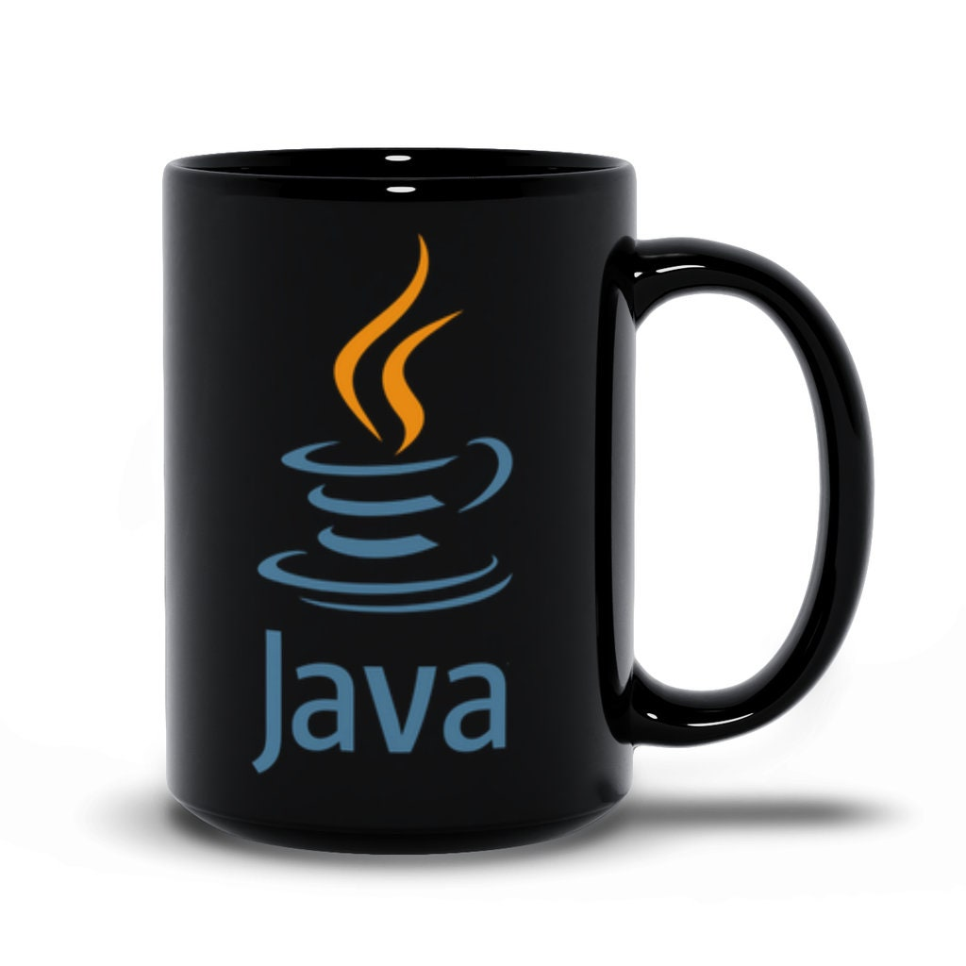
ADVANCED COMPUTER PROGRAMMING
What is Java?
Java is a high-level, class-based, object-oriented programming language designed to have as few implementation dependencies as possible.
It follows the principle of "Write Once, Run Anywhere" (WORA).
3 Billion+
Created by
James Gosling
Devices run Java worldwide
Java in the Modern Era
First released in 1995 at Sun Microsystems. Today, Java powers enterprise applications, Android development, web backends, big data systems, and cloud services.
09

Slide 10
ADVANCED COMPUTER PROGRAMMING
Core Components of Java
JDK
Java Development Kit
Java API
Complete software development environment for building Java applications. Includes JRE + compiler, debugger, and development tools.
Collection of pre-written classes and packages for common programming tasks.
JRE
Java Runtime Environment
Development Tools
Provides libraries, JVM, and components needed to run Java applications. Does not include development tools.
Compiler (javac), debugger (jdb), archiver (jar), and documentation generator (javadoc).
JVM
Java Virtual Machine
Class Libraries
The core engine that executes Java bytecode and enables platform independence. Converts bytecode to native machine code.
Core libraries for I/O, networking, collections, concurrency, and GUI development.
10

Slide 11
ADVANCED COMPUTER PROGRAMMING
JDK, JRE, and JVM Relationship
JDK
Java Development Kit
Complete toolkit for Java development: JRE + Compiler (javac) + Debugger (jdb) + Archiver (jar) + Documentation tools
JRE
Java Runtime Environment
Everything needed to run Java: JVM + Class libraries + Supporting files
JVM
Java Virtual Machine
Executes bytecode, enables platform independence
Relationship: JDK ⊃ JRE ⊃ JVM — You need JDK to develop, JRE to run, and JVM is the execution engine.
11

Slide 12

03
HISTORY & FEATURES OF JAVA
The Evolution and Characteristics That Define Java

Slide 13
ADVANCED COMPUTER PROGRAMMING
Brief History of Java
Project "Green" started at Sun Microsystems by James Gosling. Initially called "Oak".
1991
Key Milestones
Java 1.0 officially released with the slogan "Write Once, Run Anywhere".
■ Originally designed for embedded systems
■ Renamed from "Oak" to "Java" (coffee-inspired)
■ Browser applets made it wildly popular
■ Enterprise adoption drove EE platform growth
■ Android (2008) made Java a mobile powerhouse
■ Open-sourced as OpenJDK in 2007
■ Modern Java focuses on performance and cloud
1995
Java 5 (Tiger) introduced generics, annotations, and enhanced for-loop.
2004
Oracle acquired Sun Microsystems, taking over Java's development.
2010
Java 8 — the most influential release: lambda expressions, streams, and new date API.
2014
Java 9 introduced the module system (Project Jigsaw) for better code organization.
2017
Java follows 6-month release cycles. Java 21 LTS brings virtual threads and pattern matching.
2023+
13

Slide 14
ADVANCED COMPUTER PROGRAMMING
Key Features of Java — Part 1
Simple
Object-Oriented
Platform Independent
Easy to learn with clean syntax. Derived from C/C++ but removes complex features like pointers and operator overloading.
Everything revolves around objects and classes, promoting modular, reusable, and maintainable code.
"Write Once, Run Anywhere" via JVM and bytecode. Compile on Windows, run on Linux or macOS seamlessly.
Secure
Robust
Why These Matter
Bytecode verification, sandbox security model, and no explicit pointers protect against malicious code and unauthorized access.
Strong memory management, automatic garbage collection, exception handling, and type checking.
These five features make Java ideal for beginners while being powerful enough for enterprise-scale applications.
14

Slide 15
ADVANCED COMPUTER PROGRAMMING
Key Features of Java — Part 2
Multithreaded
Portable
High Performance
Supports concurrent execution of multiple threads for better performance.
The same bytecode runs on any platform with a JVM. No recompilation needed when moving between Windows, Linux, or macOS.
JIT (Just-In-Time) compiler optimizes bytecode to native machine code at runtime, delivering near-native execution speed.
Distributed
Dynamic
Built-in networking support with RMI, CORBA, and sockets. Designed for creating applications that run across networks and the internet.
Supports dynamic loading of classes and libraries at runtime. Adapts to evolving environments with reflection and dynamic compilation.
These ten features — Simple, OOP, Platform-Independent, Secure, Robust, Multithreaded, Portable, High Performance, Distributed, and Dynamic — make Java one of the most versatile programming languages.
15

Slide 16

04
JAVA COMPILATION PROCESS
From Source Code to Execution

Slide 17
ADVANCED COMPUTER PROGRAMMING
How Java Compilation Works
STEP 1: WRITE
STEP 2: COMPILE
STEP 3: EXECUTE
Write Java source code in a .java file using a text editor or IDE
javac compiler translates .java into bytecode (.class files)
JVM loads .class file, verifies bytecode, and executes via interpreter or JIT compiler
Compilation (javac)
Execution (JVM)
▶ Parses source code into Abstract Syntax Tree (AST)
▶ Performs semantic analysis (type checking)
▶ Generates platform-independent bytecode
▶ Output: .class files containing bytecode
▶ Class Loader loads .class files into memory
▶ Bytecode Verifier checks security and validity
▶ Execution Engine interprets or JIT-compiles
▶ Result: Native machine code execution
Key Difference: Unlike C/C++ that compile directly to machine code, Java compiles to intermediate bytecode that runs on any platform with a JVM — this is the foundation of "Write Once, Run Anywhere."
17

Slide 18
ADVANCED COMPUTER PROGRAMMING
Inside the JVM Execution Engine
Class Loader
Bytecode Verifier
Execution Engine
Garbage Collector
Loads .class files into memory. Uses delegation model: Bootstrap → Extension → Application.
Ensures bytecode is safe and valid. Checks type safety, stack overflow, and proper object usage.
Interprets bytecode or uses JIT compilation. The core runtime that brings Java code to life.
Automatically removes unused objects from heap memory, preventing memory leaks.
Tiered Compilation Strategy
Level | Compiler | Strategy | Best For
Level 0 | Interpreter | 100% interpreted, no compilation | Cold code, initial startup
Level 1-2 | C1 (Client) | Fast compilation with basic profiling | Short-lived applications
Level 3 | C1 + Profile | Full profiling data collection | Gathering execution statistics
Level 4 | C2 (Server) | Aggressive optimizations | Long-running applications
18

Slide 19

05
TYPES OF JAVA APPLICATIONS
Exploring the Diverse Applications Built with Java

Slide 20
ADVANCED COMPUTER PROGRAMMING
Categories of Java Applications
Standalone / Desktop Applications
Web Applications
Traditional software running on a single machine using AWT, Swing, or JavaFX for GUI.
Server-side applications using Servlets, JSP, and Spring Framework for dynamic web content.
Enterprise Applications
Mobile Applications
Large-scale distributed systems using Java EE/Jakarta EE for banking, insurance, and ERP.
Android apps (primarily Java or Kotlin) — millions of apps on Google Play Store.
Embedded Systems
Programs running on small devices, IoT, and microcontrollers using Java ME.
20

Slide 21
ADVANCED COMPUTER PROGRAMMING
Java Application Examples in Industry
Industry | Companies / Platforms | Use Case
Enterprise | LinkedIn, Amazon, Netflix | Backend systems, microservices
Mobile | Android ecosystem | Millions of apps on Google Play
Big Data | Hadoop, Apache Spark, Kafka | Distributed data processing
Financial | Goldman Sachs, Barclays | Trading platforms, banking systems
E-commerce | eBay, Alibaba | High-volume transaction processing
Government | NASA, IRS | Mission-critical systems
Java's reliability, scalability, and security make it the top choice for mission-critical applications across virtually every industry.
21

Slide 22

06
JAVA DEVELOPMENT KIT & EDITIONS
Understanding JDK, JRE, JVM and Java Platform Editions

Slide 23
ADVANCED COMPUTER PROGRAMMING
Java Editions Overview
Java SE
Standard Edition
Java EE / Jakarta EE
Core platform for general-purpose programming. Includes JVM, JDK, JRE, and core libraries (Collections, IO, Networking, Concurrency, JDBC).
Enterprise Edition for large-scale, distributed apps. Includes Servlets, JSP, JPA, EJB, JMS, Web Services, and Dependency Injection.
Java ME
Micro Edition
JavaFX
For resource-constrained devices: mobile phones, IoT devices, and embedded systems. Uses subset of SE APIs with CLDC and MIDP.
Rich client GUI applications with modern UI controls, 2D/3D graphics, charts, audio/video, and CSS styling support.
Quick Comparison
Aspect | Java SE | Java EE | Java ME | JavaFX
Primary Use | General purpose | Enterprise web | Mobile/embedded | Desktop GUI
Scale | Any | Large | Small | Desktop
23

Slide 24
ADVANCED COMPUTER PROGRAMMING
JDK Components and Tools
Tool | Name | Description
javac | Java Compiler | Converts Java source code (.java) into platform-independent bytecode (.class)
java | Java Interpreter | Launches Java applications by loading and executing bytecode files
javadoc | Documentation Generator | Generates API documentation in HTML from source code comments
jar | Java Archiver | Packages multiple class files and resources into a single JAR archive
jdb | Java Debugger | Helps find and fix bugs through breakpoints and step-by-step execution
javap | Class Disassembler | Examines bytecode instructions within compiled .class files
jconsole | JVM Monitor | Monitors JVM performance: memory usage, threads, and garbage collection
keytool | Key & Certificate Tool | Manages security certificates, keystores, and truststores
24

Slide 25

07
JAVA DEVELOPMENT TOOLS
Build Tools, Frameworks, and the Java Ecosystem

Slide 26
ADVANCED COMPUTER PROGRAMMING
Java Build Tools: Ant, Maven, Gradle
Apache Ant
2000
Apache Maven
2004
Gradle
2007
Style: XML-based scripts
Philosophy: "Do exactly what I say"
▶ Very flexible and customizable
▶ Good for small projects
■ Verbose XML
■ No built-in dependency mgmt
Style: Convention-over-config
Philosophy: "Follow the rules"
▶ Powerful dependency mgmt
▶ Standardized structure
■ XML still verbose
■ Less flexible than Ant
Style: Groovy/Kotlin DSL
Philosophy: "Best of both worlds"
▶ Concise, readable scripts
▶ Fastest builds (caching)
■ Steeper learning curve
■ DSL may be unfamiliar
Today's recommendation: Learn Maven for enterprise Java projects. Learn Gradle for Android and modern large-scale projects. Ant is mostly legacy.
26

Slide 27
ADVANCED COMPUTER PROGRAMMING
Essential Java Development Ecosystem
Version Control
Testing Frameworks
Frameworks
Git, GitHub, GitLab, Bitbucket for code management, collaboration, and version tracking.
JUnit and TestNG for unit testing, integration testing, and behavior-driven development.
Spring / Spring Boot for enterprise, Hibernate for ORM, Jakarta EE for web.
CI / CD
IDEs
Package Repositories
Jenkins, GitHub Actions, GitLab CI for automated building, testing, and deployment.
IntelliJ IDEA, Eclipse, VS Code, NetBeans with rich plugin ecosystems.
Maven Central, JCenter for distributing and resolving project dependencies.
A modern Java developer works with this entire ecosystem — not just the language, but the complete toolchain for professional development.
27

Slide 28
WEEK 1 COMPLETE
KEY TAKEAWAYS
■ Java is a powerful, platform-independent, object-oriented language with a rich ecosystem
■ Understanding IDEs, JDK/JRE/JVM, and the compilation process is essential
■ Development tools like Maven and Gradle streamline professional workflows
"Write Once, Run Anywhere"
— Java's core philosophy that has stood the test of time

